Slide 1
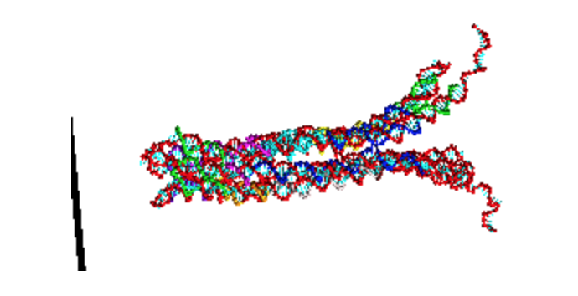
Using oxDNA to study the DNAlien
Pore mobility vs tether length – initial findings
JOEL HOCHSTETTER

Slide 2
Methodology
This initial set of simulations focuses on investigating the mobility of the pore according to different tether lengths
When I refer to tether length, I mean number of nucleotides between the connection of tether to pore and connection of tether to barrel. The total number of nucleotides on the tether is twice this
5 different lengths are chosen (20, 30, 40, 50, 60) nt and Molecular Dynamics simulations between these are compared.
At this stage, the motion of the free pore is studied (no cinches or connectors)

Slide 3
Running simulation step-by-step
Use python to generate json of pore with tether of length n (n = 20,30,40,50,60)
Use python to convert json file format to oxDNA file format
Relax pore in oxDNA without forces so structure does not fall apart. This ensures that the structure minimizes free energy. This is important for forced crossovers.
Introduce forces (fixing ends of tether then introducing force planes). Each force is introduced by gradually increasing the strength of the force to prevent damage.
Run Molecular dynamics simulation for 1e9 time-steps (30us) with forces. This produces a trajectory file which stories positions and orientations of nucleotides, as well as their velocities, angular velocities and energies.
Use python to process data and extract relevant information from trajectory file.
Analyse data to compare different simulations
Use cogli1 (+ povray + ffmpeg) to produce movies of the simulation
Use Python to plot histogram and compare statistics

Slide 4
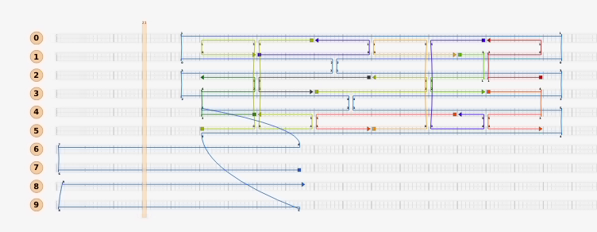
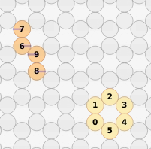
Pore used: 190604_TC_pore_cinch1.json
I reproduced this without the barrel and cinches
I vary tether length (number of nt in helices 5-9)
ù

Slide 5
Set-up for simulation - forces
Top view
Side view
‘Force planes’ prevent pore exiting barrel (I use 8 to simulate barrel)
End nucleotides of the tether are fixed to a certain position
19.6nm

Slide 6
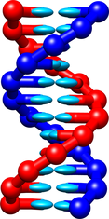
Key simulation parameters in oxDNA
Length of simulation 0.03ms.
Molecular Dynamics simulations are performed (the other option is Monte Carlo)
Temperature 300K
Salt concentration 0.5M
Other parameters are defaults (see https://dna.physics.ox.ac.uk/index.php/DNA_model_introduction)

Slide 7
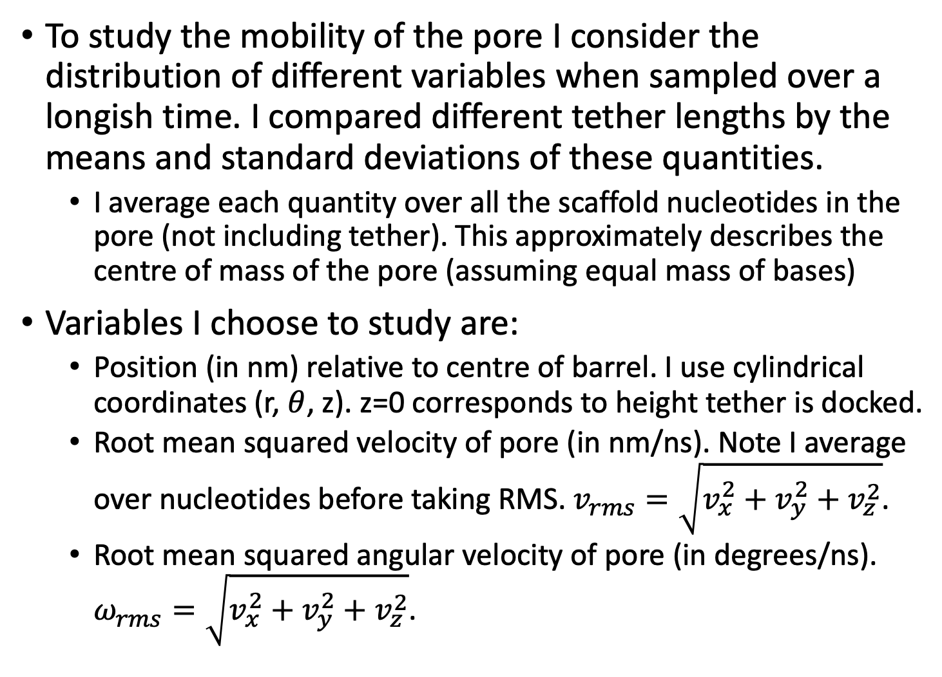
Quantities of interest for pore mobility
To study the mobility of the pore I consider the distribution of different variables when sampled over a longish time. I compared different tether lengths by the means and standard deviations of these quantities.
I average each quantity over all the scaffold nucleotides in the pore (not including tether). This approximately describes the centre of mass of the pore (assuming equal mass of bases)
Variables I choose to study are:
Position (in nm) relative to centre of barrel. I use cylindrical coordinates (r, $θ$, z). z=0 corresponds to height tether is docked.
Root mean squared velocity of pore (in nm/ns). Note I average over nucleotides before taking RMS. $v_{rms}=\sqrt{v_{x}^{2}+v_{y}^{2}+v_{z}^{2}}$.
Root mean squared angular velocity of pore (in degrees/ns). $ω_{rms}=\sqrt{v_{x}^{2}+v_{y}^{2}+v_{z}^{2}}$.
The origin is the centre of the barrel

Slide 8
Comparison by tether length – position
- 60 bp tether can be explained by formation of a hairpin effectively shortening length of tether. E.g. see video for this on a later slide
For this pore as tether length shortens, the average position of the pore (described by both radial and vertical) approaches the centre of the barrel
The average position in the barrel is offset from centre with the average angular position is approximately constant. This is because the connections between tether and pore are asymmetric.

Slide 9
Comparison by tether length - velocity
As the tether length increases the RMS velocity and RMS angular velocity both increase
Again an outlier at bp = 60 is due to hairpin formation

Slide 10
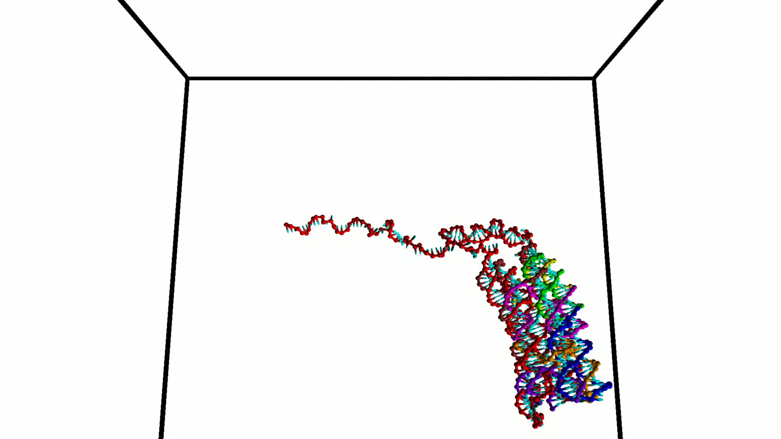
Now looking at each tether length
The videos suggest this pore is not very structurally stable (at least compared to the shorter pore which was designed for Biomod). Old biomod pore shown below, with new pore on next slide. The new pore is longer and appears more flexible.
Key observations shown in next few slides.
Rest of videos shown at end of ppt.
Rest of histogram figures shown in my
notebook which is linked from this ppt.

Slide 11
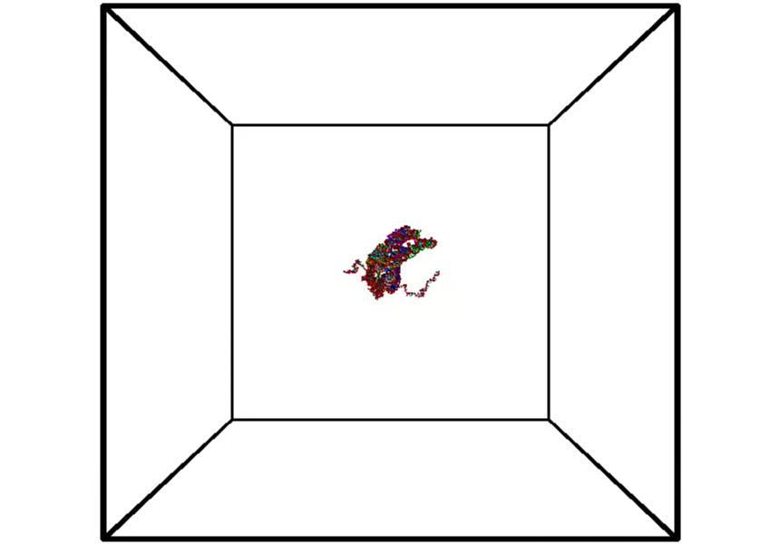
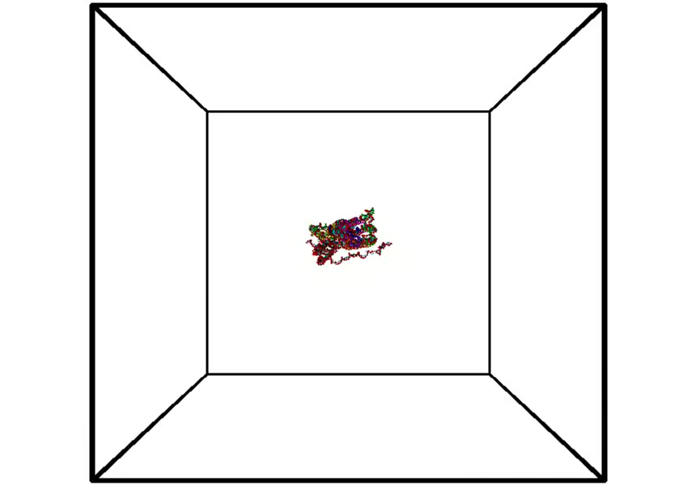
Tether length = 40 vs Tether length = 60
Both show pore is quite flexible and can flip. Sometimes face up and other times down
Can observe hairpin forms on right side tether (for tether length 60, in early times for example

Slide 12
Tether length = 40 vs Tether length = 60
The longer tether lengths seem to prefer to spend more time near the centre near the pore (as seen earlier) from the limited data taken so far. For both plots the tail of the distribution on the left hand side (decreasing z position) is long but drops off more rapidly then on the right hand side. This means the pore spends a majority of its time close to the centre of the barrel. However, the tether can extend, allowing the pore to explore locations further along barrel. These positions are where pore needs to reside, when changing into the other conformations (such as `attack mode’ of the DNAlien).

Slide 13
Tether length = 40 vs Tether length = 60
The longer tethered pore spends more time close to the centre of the barrel.

Slide 14
Tether length = 40 vs Tether length = 60
As described before. This pore has a preferred angular orientation due to the asymmetry of the connection of the tether to the pore.

Slide 15
Tether length = 40 vs Tether length = 60
Velocity distributions (both translational and rotational) are comparable. Remember that 60 tether forms hairpin

Slide 16
Summary of findings
The longer the tether length the larger the variation in position and closer the average position (both vertical and radial) to the centre of the barrel.
The longer the tether, the higher the root mean squared velocity and angular velocity of the pore.
The formation of hairpins reduces the mobility of the pore.
The pore is flexible and can `flip orientations’ (sometimes face up and sometimes face down) within the centre of the barrel

Slide 17
To work on next
Running longer simulation (and also using Monte Carlo) will allow a better sampling of the space that the pore can move. In particular videos suggest pore may be able to rotate 180 degrees in barrel. This will allow better estimation of the distribution.
I will try using actual sequences (I used random scaffold), or vary sequences to see if I can reduce formations of hairpins, which may readily form at longer tether lengths.
I can change these simulations so that I add cinches / handles. Hopefully this will help explain why cinches don’t work experimentally.

Slide 18
Some further links if you’re interested
For my analysis code and plots as a Jupyter notebook https://github.com/joelhochstetter/DNAnano/blob/master/oxDNA/NewPore/VaryTethLen2/VaryTetherLength.ipynb
Rest of my code is available on my github. Mixture between shell scripts (bash and cshell), python scripts, oxDNA parameter files https://github.com/joelhochstetter/DNAnano/blob/master/oxDNA/NewPore

Slide 19
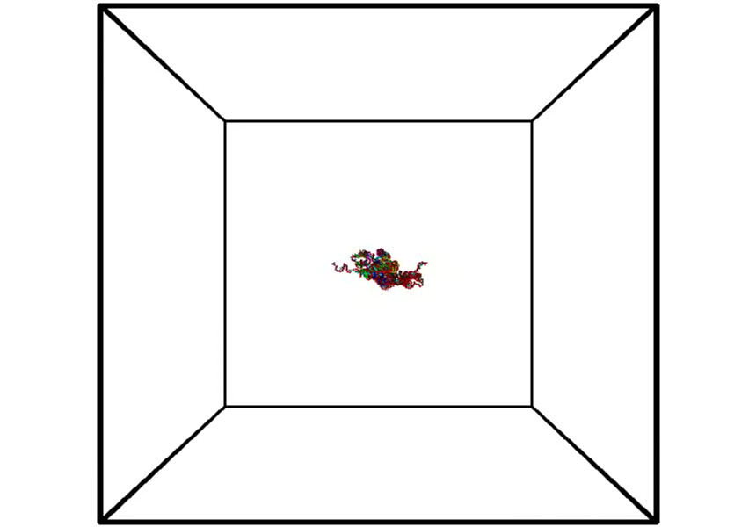
Tether length = 20

Slide 20
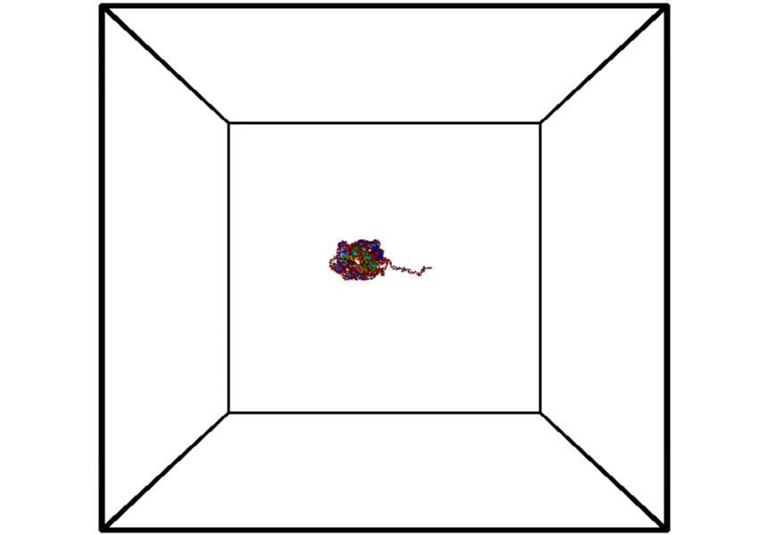
Tether length = 30

Slide 21
Tether length = 40

Slide 22
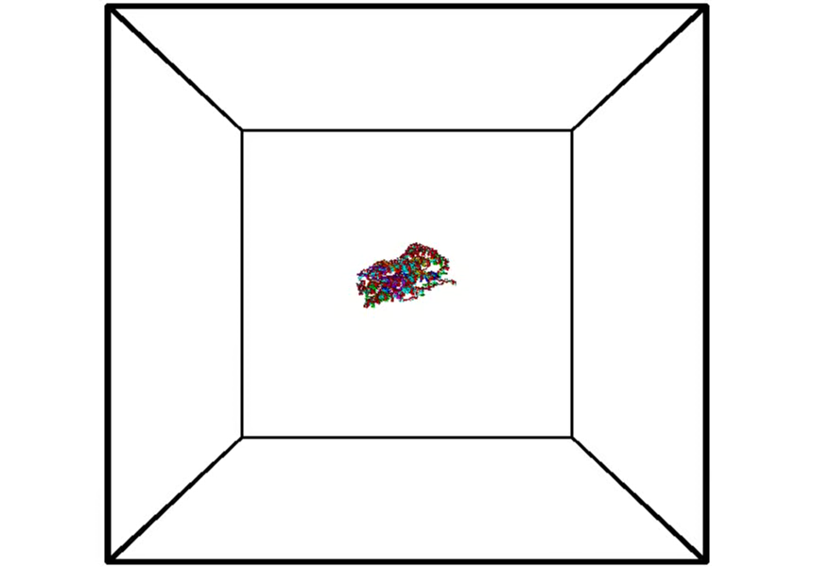
Tether length = 50

Slide 23
Tether length = 60

